Slide 1
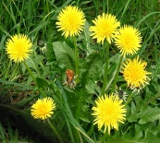
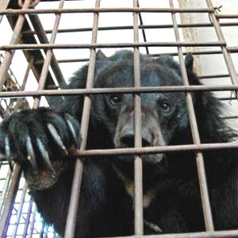
1) Brainstorm in book:
What do dandelions symbolise in the book?
2) Answer in your exercise book:
What is the purpose of this flashback?
  What new information does it give us about Katniss?
  How might this information be relevant for what is to come?
  Do we find out any more information about her relationships with the other characters in the book?
Flashback!
“We obey and he circles us, prodding us like animals at times, checking our muscles, examining our faces.”
3) Answer on your theme page for humanity : How does the simile in this quote add to the theme of humanity? What does it tell us about the humanity of those in the arena?

Slide 2
Embedded Clause
“He hasn’t accepted his death. He is already
fighting hard to stay alive. Which also means
that kind Peeta Mellark, the boy who gave
me the bread, is fighting hard to kill me.”
Class Discussion
Where is the embedded clause?
What is its purpose in this quote?

Slide 3
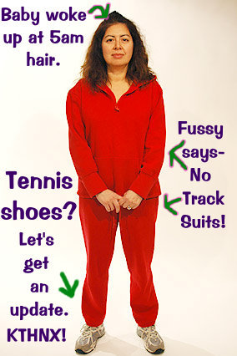
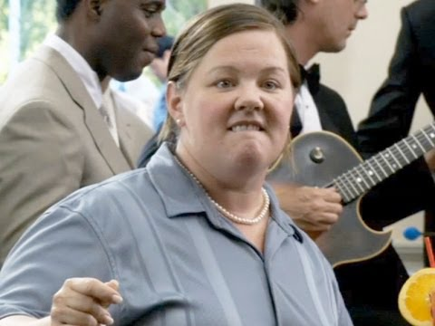
You own a beauty salon which one of these women visits. You can give them any treatments you wish (including surgery) and money is no object. Which would you choose?
Discuss with your partner?

Slide 4
Lesson Objectives
To have explored the theme of beauty in the novel.
To be able to explain the symbolic importance of Katniss’s costume in the opening ceremony and to have created your own costume.

Slide 5
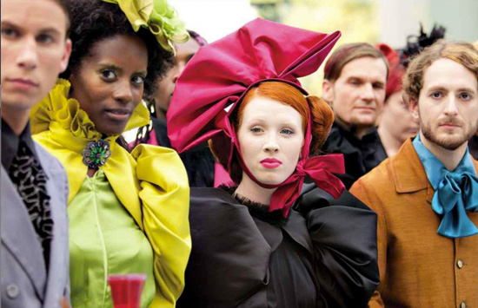
T-P-S:
How do Katniss’s looks
differ from the
Capitol inhabitants?
Which do you think is the most attractive?
Do you think it’s believable that in the future
humans will want to look like the Capitol
inhabitants?

Slide 6
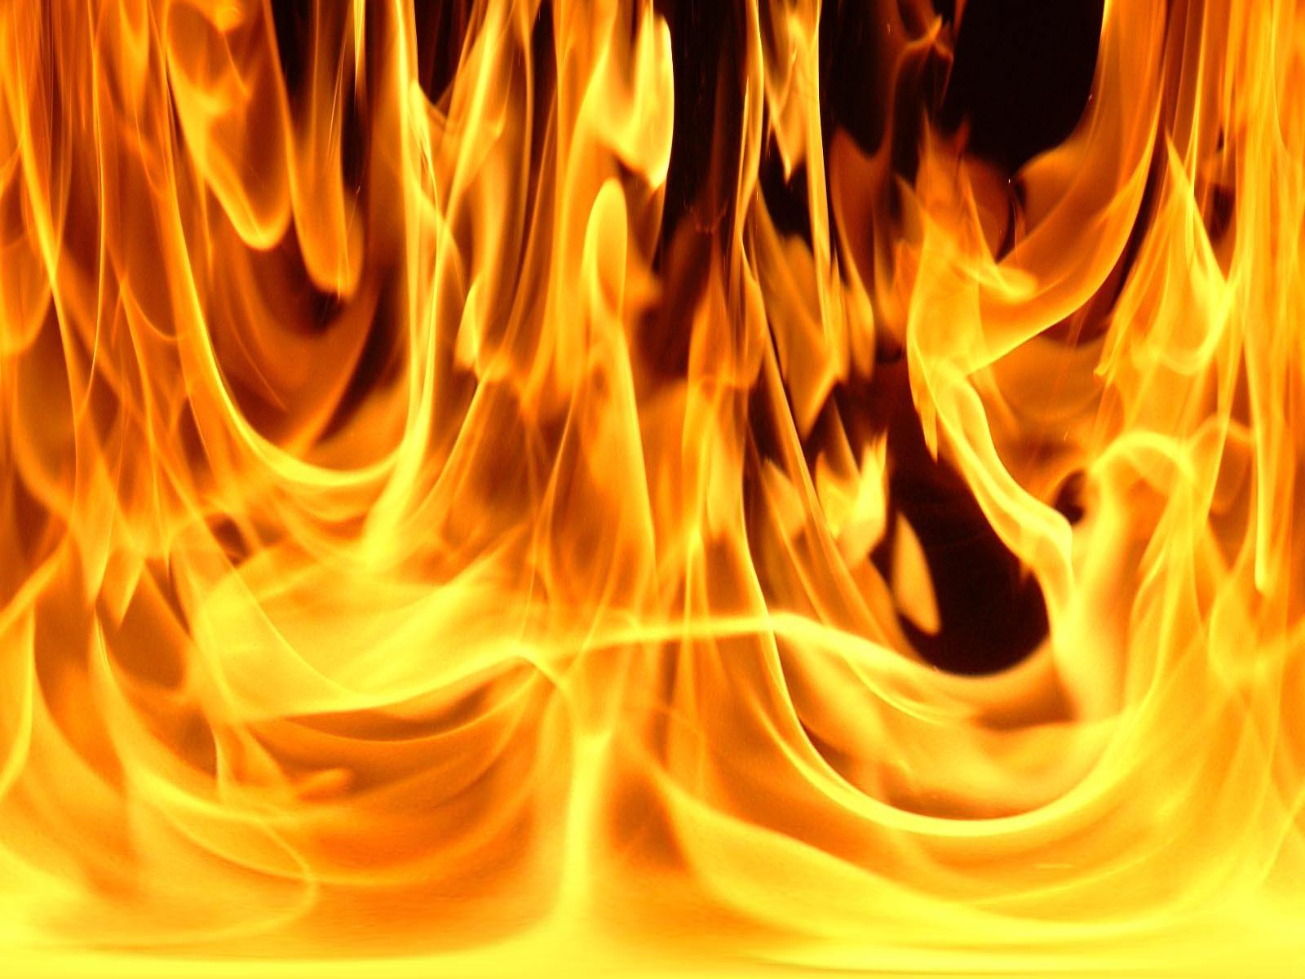
What does fire symbolise?
Why do you think Cinna chose it for their costumes?
Add your thoughts to your ‘fire-motif’ page

